Slide 1

Going Serverless with AWS
Suman Debnath

Slide 2

Serverless Computing
Serverless Architecture
Serverless Application with Python

Slide 3
Serverless Computing
Serverless Architecture
Serverless Application with Python

Slide 4

Serverless Computing
Build and run applications without thinking about servers

Slide 5


Serverless Computing
No servers to provision,
scale or manage
Flexible scaling
Built-in availability
and
fault tolerance

Slide 6

AWS Lambda
Run code without thinking about servers
Pay for only the compute time you consume
Lambda takes care of everything required to run and scale your code with high availability

Slide 7
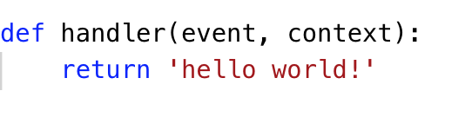
AWS Lambda Function

Slide 8
AWS Lambda Function

Slide 9
AWS Lambda Function
1
Define python function

Slide 10
AWS Lambda Function
1
Define python function
2
event - data about what triggered invocation context - runtime information about your function

Slide 11
AWS Lambda Function
1
Define python function
2
event - data about what triggered invocation context - runtime information about your function
3
Return value sent back as response

Slide 12
AWS Lambda Function
1
Define python function
2
event - data about what triggered invocation context - runtime information about your function
app.py
3
Return value sent back as response

Slide 13
AWS Lambda Function
1
Define python function
2
event - data about what triggered invocation context - runtime information about your function
app.py
3
Return value sent back as response

Slide 14
AWS Lambda Function
1
Define python function
2
event - data about what triggered invocation context - runtime information about your function
app.py
3
Return value sent back as response
$ python
>>> import app
>>> app.handler(event={}, context=None)
'hello world!'

Slide 15
AWS Lambda Function
1
Define python function
2
event - data about what triggered invocation context - runtime information about your function
app.py
3
Return value sent back as response

Slide 16
AWS Lambda Function
1
Define python function
2
event - data about what triggered invocation context - runtime information about your function
app.py
3
Return value sent back as response
$ pip install awscli

Slide 17
AWS Lambda Function
1
Define python function
2
event - data about what triggered invocation context - runtime information about your function
app.py
3
Return value sent back as response
$ pip install awscli
$ aws config

Slide 18
AWS Lambda Function
1
Define python function
2
event - data about what triggered invocation context - runtime information about your function
app.py
3
Return value sent back as response

Slide 19
AWS Lambda Function
1
Define python function
2
event - data about what triggered invocation context - runtime information about your function
app.py
3
Return value sent back as response
$ aws lambda create-function
--function-name hello
--handler app.handler
--runtime python3.6
--role arn:aws:iam::635100884080:role/MyApp
--zip "fileb://./app.zip"

Slide 20
AWS Lambda Function
1
Define python function
2
event - data about what triggered invocation context - runtime information about your function
app.py
3
Return value sent back as response
$ aws lambda create-function
--function-name hello
--handler app.handler
--runtime python3.6
--role arn:aws:iam::635100884080:role/MyApp
--zip "fileb://./app.zip”
$ aws lambda invoke --function-name hello output

Slide 21
AWS Lambda Function
1
Define python function
2
event - data about what triggered invocation context - runtime information about your function
app.py
3
Return value sent back as response
$ aws lambda create-function
--function-name hello
--handler app.handler
--runtime python3.6
--role arn:aws:iam::635100884080:role/MyApp
--zip "fileb://./app.zip”
$ aws lambda invoke --function-name hello output
$ cat output
hello world!

Slide 22
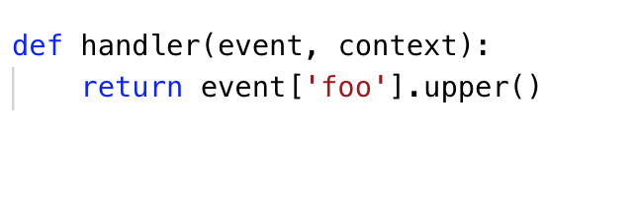
AWS Lambda Function Input
app.py

Slide 23
AWS Lambda Function Input
app.py
$ aws lambda invoke --function-name hello --payload ‘{“foo": ”bar"}' output

Slide 24
AWS Lambda Function Input
app.py
$ aws lambda invoke --function-name hello --payload ‘{“foo": ”bar"}' output

Slide 25
AWS Lambda Function Input
app.py
$ aws lambda invoke --function-name hello --payload ‘{“foo": ”bar"}' output
$ cat output
BAR

Slide 26
AWS Lambda Function Input
app.py
$ aws lambda invoke --function-name hello --payload ‘{“foo": ”bar"}' output
$ cat output
BAR
$ aws lambda invoke --function-name hello --payload ‘{“foo": ”baz"}' output

Slide 27
AWS Lambda Function Input
app.py
$ aws lambda invoke --function-name hello --payload ‘{“foo": ”bar"}' output
$ cat output
BAR
$ aws lambda invoke --function-name hello --payload ‘{“foo": ”baz"}' output
$ cat output
BAZ

Slide 28
AWS Lambda Function Invocation

Slide 29
AWS Lambda Function Invocation
$ aws lambda invoke --function-name hello --payload ‘{“foo": ”bar"}' output

Slide 30
AWS Lambda Function Invocation
$ aws lambda invoke --function-name hello --payload ‘{“foo": ”bar"}' output
Download Code

Slide 31
AWS Lambda Function Invocation
$ aws lambda invoke --function-name hello --payload ‘{“foo": ”bar"}' output
Download Code
Start new container

Slide 32
AWS Lambda Function Invocation
$ aws lambda invoke --function-name hello --payload ‘{“foo": ”bar"}' output
Download Code
Start new container
Bootstrap the runtime

Slide 33
AWS Lambda Function Invocation
$ aws lambda invoke --function-name hello --payload ‘{“foo": ”bar"}' output
Download Code
Start new container
Bootstrap the runtime
Start Code

Slide 34
AWS Lambda Function Invocation
$ aws lambda invoke --function-name hello --payload ‘{“foo": ”bar"}' output
Download Code
Start new container
Bootstrap the runtime
Start Code
Cold Start

Slide 35
AWS Lambda Function Invocation
$ aws lambda invoke --function-name hello --payload ‘{“foo": ”bar"}' output
Download Code
Start new container
Bootstrap the runtime
Start Code
Cold Start
Warm Start

Slide 36
AWS Lambda Function Invocation
$ aws lambda invoke --function-name hello --payload ‘{“foo": ”bar"}' output
Download Code
Start new container
Bootstrap the runtime
Start Code
Cold Start
Warm Start
$ aws lambda invoke --function-name hello --payload ‘{“foo": ”baz"}' output

Slide 37
Serverless Computing
Serverless Architecture
Serverless Application with Python

Slide 38
Serverless Architecture Patterns

Slide 39





Serverless Architecture
Event Trigger
Lambda
Services
Amazon API Gateway
Amazon DynamoDB
Timer
SQS message
Amazon S3

Slide 40
Serverless Architecture
Event Trigger
Lambda
Services
Amazon API Gateway
Amazon DynamoDB
Timer
Think in terms of events
SQS message
Amazon S3

Slide 41
Serverless Architecture
Event Trigger
Lambda
Services
Amazon API Gateway
Amazon DynamoDB
Timer
SQS message
Amazon S3

Slide 42
Serverless Architecture
Event Trigger
Lambda
Services
Amazon API Gateway
Amazon DynamoDB
Timer
SQS message
Amazon S3
Decompose code into separate functions

Slide 43
Synchronous Invocation
Event Trigger
Lambda
Manual Invocation
$ aws lambda invoke

Slide 44
Synchronous Invocation
Event Trigger
Lambda
GET /users
REST API Request
{“http”: “response”}

Slide 45
Async Invocation
Event Trigger
Lambda
Services

Slide 46
Async Invocation
Event Trigger
Lambda
Services
1
Amazon S3
Object upload

Slide 47
Async Invocation
Event Trigger
Lambda
Services
1
Amazon S3
Object upload
2
Return immediately

Slide 48
Async Invocation
Event Trigger
Lambda
Services
1
Amazon S3
Object upload
2
3
Event trigger notification
Return immediately

Slide 49
Async Invocation
Event Trigger
Lambda
Services
1
Amazon S3
Object upload
4
Generates thumbnail
2
3
Event trigger notification
Return immediately

Slide 50
Async Invocation
Event Trigger
Lambda
Services
1
Amazon S3
Object upload
4
Generates thumbnail
2
3
Event trigger notification
Return immediately
5
Uploads to output bucket
Upload complete

Slide 51
Stream/Poll Invocation
Event Trigger
Lambda Poller
Lambda

Slide 52
Stream/Poll Invocation
Event Trigger
Lambda Poller
Lambda
1
Amazon SQS
message added
2
Return immediately

Slide 53
Stream/Poll Invocation
Event Trigger
Lambda Poller
Lambda
1
Amazon SQS
message added
2
3
Poll for messages
Return immediately

Slide 54
Stream/Poll Invocation
Event Trigger
Lambda Poller
Lambda
1
Amazon SQS
message added
2
3
Poll for messages
Return immediately
4
Message batch

Slide 55
Stream/Poll Invocation
Event Trigger
Lambda Poller
Lambda
1
Amazon SQS
message added
2
3
Poll for messages
Return immediately
4
Message batch
5
Lambda function invoked

Slide 56
Stream/Poll Invocation
Event Trigger
Lambda Poller
Lambda
1
Amazon SQS
message added
2
3
Poll for messages
Return immediately
4
Message batch
5
Lambda function invoked
Function execution finished

Slide 57
Synchronous
Asynchronous
Stream
Blocks until response is returned from Lambda function
Lambda function triggered in response to an event, decoupled from event trigger
Lambda service polls for changes on a stream, invokes Lambda function with batch of messages

Slide 58
Synchronous
Asynchronous
Stream
Blocks until response is returned from Lambda function
Lambda function triggered in response to an event, decoupled from event trigger
Lambda service polls for changes on a stream, invokes Lambda function with batch of messages
$ aws lambda invoke
Amazon API Gateway
request
/users

Slide 59

Synchronous
Asynchronous
Stream
Blocks until response is returned from Lambda function
Lambda function triggered in response to an event, decoupled from event trigger
Lambda service polls for changes on a stream, invokes Lambda function with batch of messages
$ aws lambda invoke
Timer
Amazon API Gateway
request
/users
Amazon S3 Object
Amazon SNS Topic

Slide 60


Synchronous
Asynchronous
Stream
Blocks until response is returned from Lambda function
Lambda function triggered in response to an event, decoupled from event trigger
Lambda service polls for changes on a stream, invokes Lambda function with batch of messages
$ aws lambda invoke
Timer
Amazon SQS Message
Amazon API Gateway
request
/users
Amazon S3 Object
Amazon DynamoDB Stream
Amazon SNS Topic
Amazon Kinesis Stream

Slide 61
Serverless Computing
Serverless Architecture
Serverless Application with Python

Slide 62
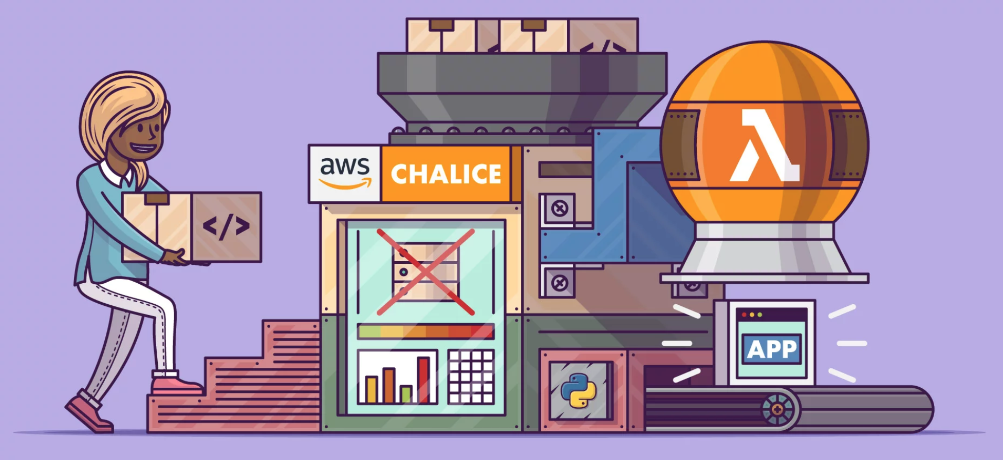
Serverless Application using Python

Slide 63
AWS Lambda

Slide 64



Setting up from scratch
AWS IAM role
IAM.put_role_policy()
IAM.create_role()
IAM policy
Lambda.create_function()
AWS Lambda
Zip of code and
dependencies

Slide 65
Setting up from scratch
AWS IAM role
IAM.put_role_policy()
IAM.create_role()
IAM policy
Lambda.create_function()
AWS Lambda
1
Zip of code and
dependencies

Slide 66
Setting up from scratch
AWS IAM role
2
IAM.put_role_policy()
IAM.create_role()
IAM policy
Lambda.create_function()
AWS Lambda
1
Zip of code and
dependencies

Slide 67
Setting up from scratch
AWS IAM role
2
IAM.put_role_policy()
IAM.create_role()
IAM policy
Lambda.create_function()
3
AWS Lambda
1
Zip of code and
dependencies

Slide 68
Creating our first Lambda Function

Slide 69
Creating our first Lambda Function
1
$ zip -r app.zip app.py

Slide 70
Creating our first Lambda Function
1
$ zip -r app.zip app.py
2
$ aws iam create-role \
--role-name MyApp \
--assume-role-policy-document '{
"Version": "2012-10-17",
"Statement": [
{
"Effect": "Allow",
"Principal": {
"Service": "lambda.amazonaws.com"
},
"Action": "sts:AssumeRole"
}
]
}'

Slide 71
Creating our first Lambda Function
1
$ zip -r app.zip app.py
3
$ aws lambda create-function \
--function-name hello \
--handler app.handler \
--runtime python3.6 \
--role arn:aws:iam::635100884080:role/MyApp \
--zip "fileb://./app.zip"
2
$ aws iam create-role \
--role-name MyApp \
--assume-role-policy-document '{
"Version": "2012-10-17",
"Statement": [
{
"Effect": "Allow",
"Principal": {
"Service": "lambda.amazonaws.com"
},
"Action": "sts:AssumeRole"
}
]
}'

Slide 72
Creating our first Lambda Function
1
$ zip -r app.zip app.py
3
$ aws lambda create-function \
--function-name hello \
--handler app.handler \
--runtime python3.6 \
--role arn:aws:iam::635100884080:role/MyApp \
--zip "fileb://./app.zip"
2
$ aws iam create-role \
--role-name MyApp \
--assume-role-policy-document '{
"Version": "2012-10-17",
"Statement": [
{
"Effect": "Allow",
"Principal": {
"Service": "lambda.amazonaws.com"
},
"Action": "sts:AssumeRole"
}
]
}'

Slide 73
Creating our first Lambda Function
1
$ zip -r app.zip app.py
3
$ aws lambda create-function \
--function-name hello \
--handler app.handler \
--runtime python3.6 \
--role arn:aws:iam::635100884080:role/MyApp \
--zip "fileb://./app.zip"
2
$ aws iam create-role \
--role-name MyApp \
--assume-role-policy-document '{
"Version": "2012-10-17",
"Statement": [
{
"Effect": "Allow",
"Principal": {
"Service": "lambda.amazonaws.com"
},
"Action": "sts:AssumeRole"
}
]
}'

Slide 74
Image Thumbnail Generator
Event Trigger
Lambda
Services
1
Amazon S3
Object upload
4
Generates thumbnail
2
3
Event trigger notification
Return immediately
5
Uploads to output bucket
Upload complete

Slide 75
Image Thumbnail Generator
AWS IAM role
IAM.put_role_policy()
IAM.create_role()
IAM policy
S3.put_bucket_notification_configuration()
Lambda.create_function()
Amazon S3
AWS Lambda
Lambda.add_permission(S3)
Notification Configuration
Zip of code and
dependencies
75

Slide 76
Image Thumbnail Generator
AWS IAM role
IAM.put_role_policy()
IAM.create_role()
IAM policy
S3.put_bucket_notification_configuration()
Lambda.create_function()
Amazon S3
AWS Lambda
1. Third party packages
2. S3 notification configuration
3. IAM Permissions
Lambda.add_permission(S3)
Notification Configuration
Zip of code and
dependencies
76

Slide 77
Image Thumbnail Generator
AWS IAM role
IAM.put_role_policy()
IAM.create_role()
IAM policy
S3.put_bucket_notification_configuration()
Lambda.create_function()
Amazon S3
AWS Lambda
1. Third party packages
2. S3 notification configuration
3. IAM Permissions
Lambda.add_permission(S3)
Notification Configuration
Zip of code and
dependencies
77

Slide 78
Image Thumbnail Generator
AWS IAM role
IAM.put_role_policy()
IAM.create_role()
IAM policy
S3.put_bucket_notification_configuration()
Lambda.create_function()
Amazon S3
AWS Lambda
1. Third party packages
2. S3 notification configuration
3. IAM Permissions
Lambda.add_permission(S3)
Notification Configuration
Zip of code and
dependencies
78

Slide 79
Image Thumbnail Generator
AWS IAM role
IAM.put_role_policy()
IAM.create_role()
IAM policy
S3.put_bucket_notification_configuration()
Lambda.create_function()
Amazon S3
AWS Lambda
1. Third party packages
2. S3 notification configuration
3. IAM Permissions
Lambda.add_permission(S3)
Notification Configuration
Zip of code and
dependencies
79

Slide 80

AWS Chailce
Python Serverless Microframework
Create and deploy serverless applications
Integration with may other AWS services

Slide 81
AWS Chalice
Lambda
handler.py
AWS Lambda

Slide 82
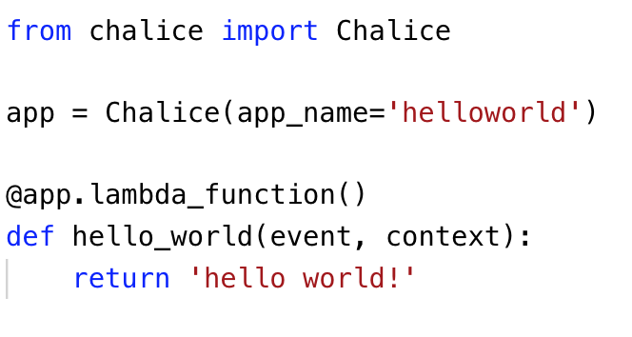
AWS Chalice
Lambda
chalice
app.py
AWS Lambda

Slide 83
AWS Chalice
Lambda
chalice
app.py
AWS Lambda
1
app defined at module level

Slide 84
AWS Chalice
Lambda
chalice
app.py
AWS Lambda
1
app defined at module level
2
one or more decorators can be defined

Slide 85
Deployment
$ chalice deploy
Creating deployment package.
Updating policy for IAM role: helloworld-dev
Creating lambda function: helloworld-dev-hello_world
Deleting Rest API: 56mbn4ke87
Deleting function: arn:aws:lambda:us-west-2:635100884080:function:helloworld-dev
Resources deployed:
- Lambda ARN: arn:aws:lambda:us-west-2:635100884080:function:helloworld-dev-hello_world
app.py
$ chalice invoke -n hello_world
"hello world!"

Slide 86
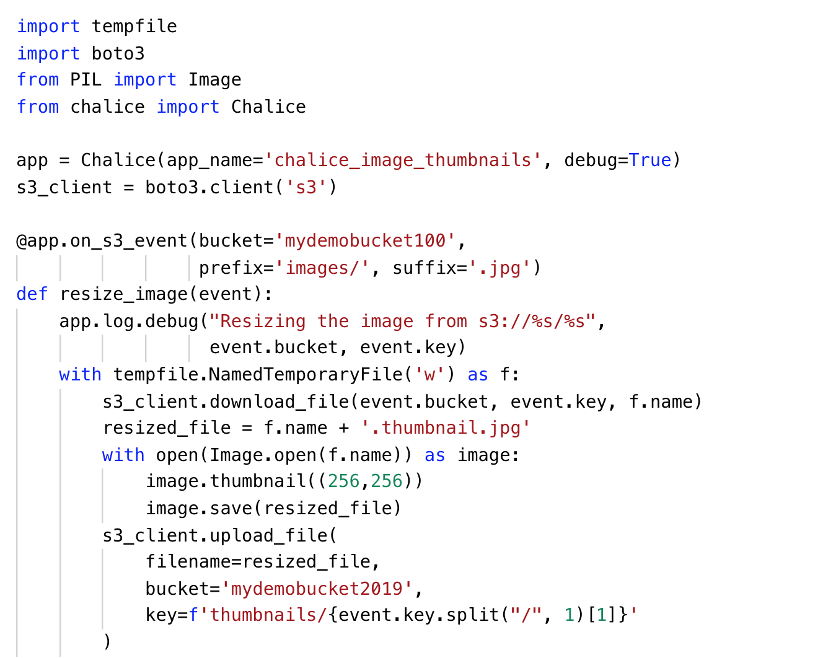
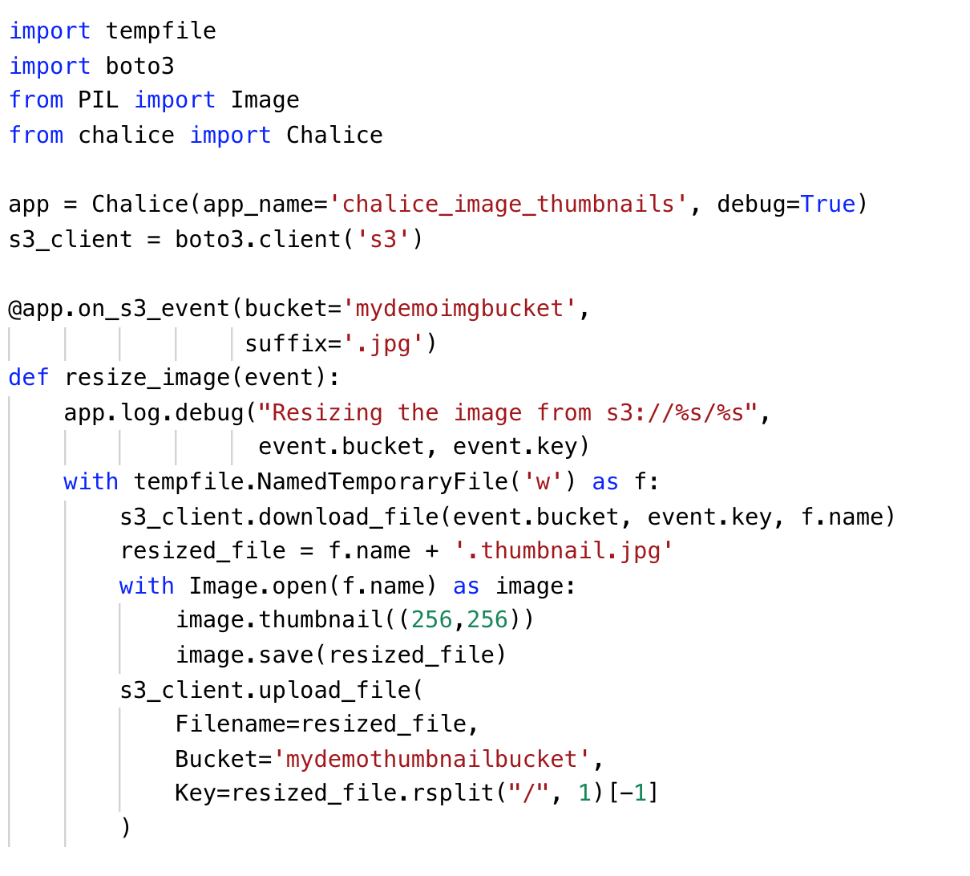
S3 Image Thumbnail Generator

Slide 87
S3 Image Thumbnail Generator
3rd party extensions automatically handled from requirements.txt

Slide 88
S3 Image Thumbnail Generator
Client created in module scope
Only part of cold-start time

Slide 89
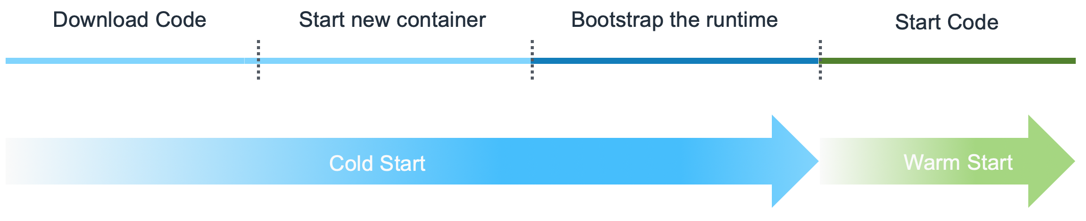
S3 Image Thumbnail Generator
Client created in module scope
Only part of cold-start time
Module Import

Slide 90
S3 Image Thumbnail Generator
Trigger function when object is uploaded to
S3://mydemoimgbucket/.jpg

Slide 91
S3 Image Thumbnail Generator

Slide 92
S3 Image Thumbnail Generator
Event dictionary mapped to python object download_file method from boto3 will download file parts in parallel

Slide 93
S3 Image Thumbnail Generator
Generate 256x256 image and save image to a temporary file

Slide 94
S3 Image Thumbnail Generator
Upload thumbnail back to S3, upload_file from boto3 will use parallelized multi part upload if needed

Slide 95



Chalice Architecture
.
├── app.py
└── requirements.txt

Slide 96
Chalice Architecture
$ chalice deploy

Slide 97
Chalice Architecture
AWS IAM role
IAM.create_role()
$ chalice deploy

Slide 98
Chalice Architecture
AWS IAM role
IAM policy
$ chalice deploy

Slide 99
Chalice Architecture
AWS IAM role
IAM.put_role_policy()
IAM policy
$ chalice deploy

Slide 100
Chalice Architecture
AWS IAM role
IAM.put_role_policy()
$ chalice deploy

Slide 101
Chalice Architecture
AWS IAM role
.
├── app.py
└── requirements.txt
$ chalice deploy

Slide 102

Chalice Architecture
Chalice runtime
AWS IAM role
deploy.zip
$ chalice deploy

Slide 103
Chalice Architecture
Chalice runtime
AWS IAM role
Lambda.create_function()
deploy.zip
AWS Lambda
$ chalice deploy

Slide 104
Chalice Architecture
Chalice runtime
AWS IAM role
Lambda.create_function()
deploy.zip
AWS Lambda
$ chalice deploy

Slide 105
Chalice Architecture
AWS IAM role
AWS Lambda
$ chalice deploy

Slide 106
Chalice Architecture
Amazon S3
S3.put_bucket_notification_configuration()
Lambda.add_permission(S3)
AWS Lambda
$ chalice deploy

Slide 107
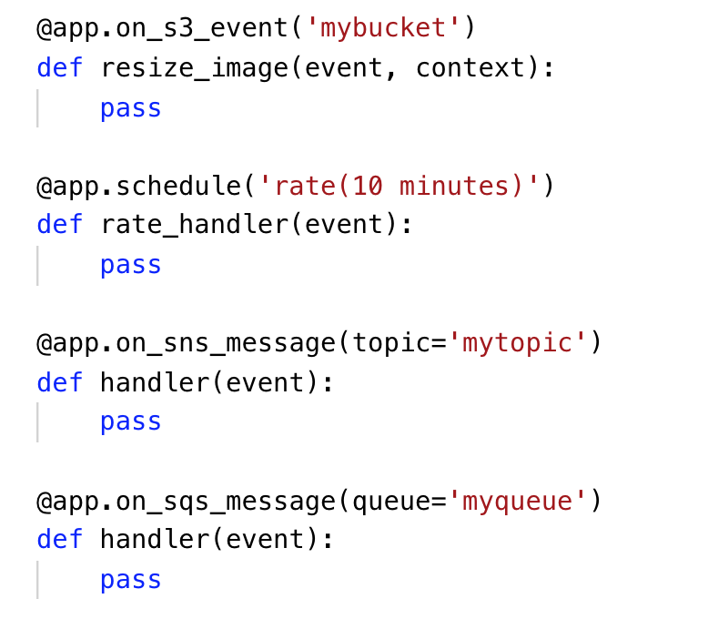
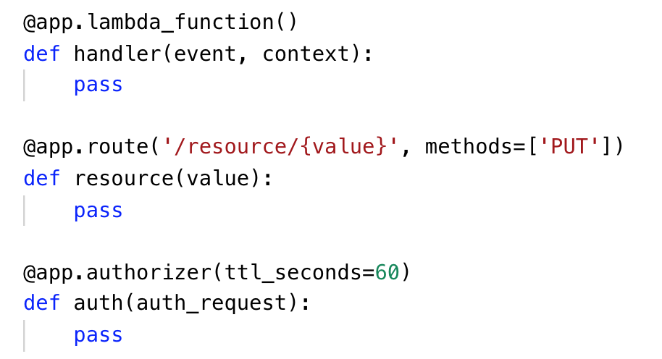
Other Chalice Decorators

Slide 108
Serverless Computing
Serverless Architecture
Serverless Application with Python

Slide 109
Resources
Introduction to AWS Lambda and Chalice
GitHub for Chalice
Serverless Framework for AWS
AWS re:Invent 2018: A Serverless Journey: AWS Lambda Under the Hood

Slide 110



@_sumand
suman.san14@yahoo.in

